Slide 1
Embeddable technology
Gerald Alvarez, Kathleen Kirkwood, Michelle Samson

Slide 2
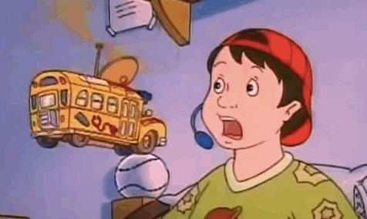
Embeddables
*Continuation of wearables
*Tiny computational devices
*Implanted inside the body
*Symbiosis of humans and machines
*The four converging technologies that will drive the development of embeddables: genetics, robotics, information, and nanotechnology
*New ways of displaying and receiving information. Moving away from the screen interface
*Domains: Anything we could think of. At present, it is trending in Healthcare and Fitness
Notes:
According to the author, this is a rather niche market. Embeddables get into or onto your skin replacing the need for a screen interface

Slide 3
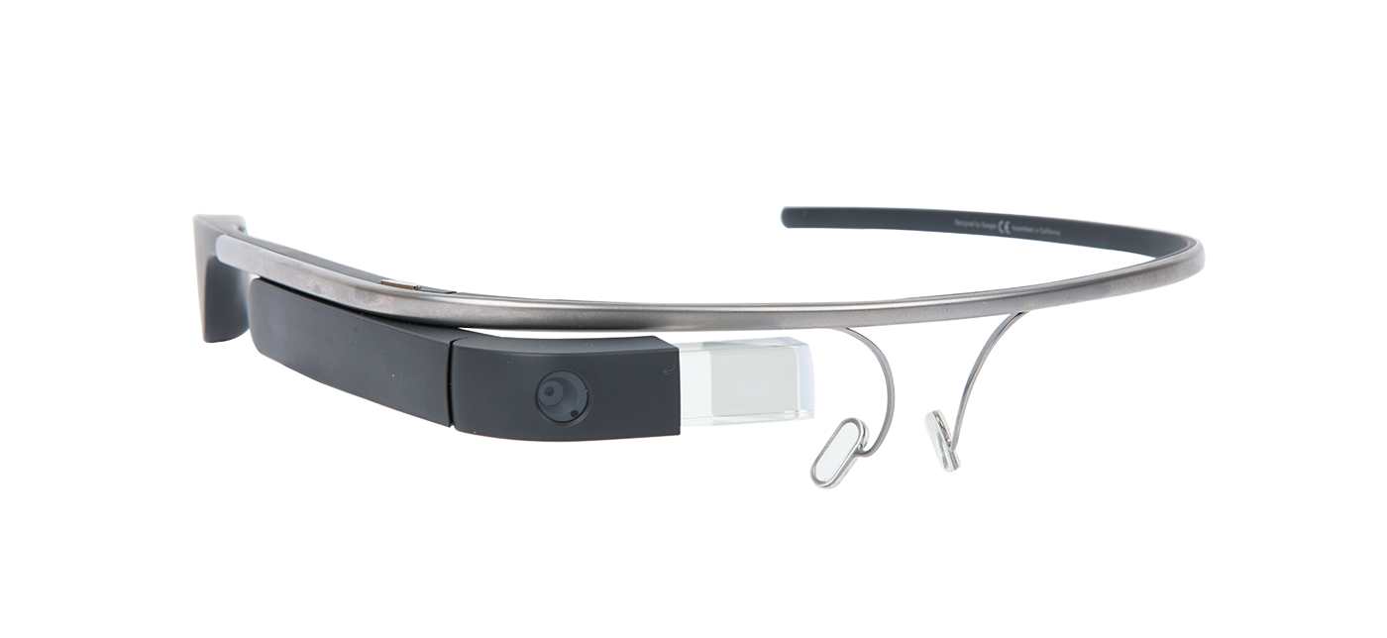
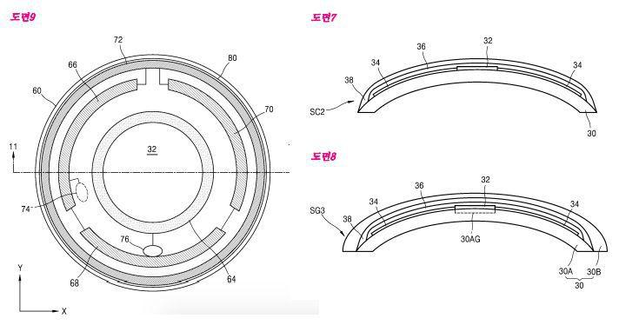
Continuation
* Balance between unobtrusiveness and practicality needs to be found.
*the design paradigm has to correspond to the user needs.
*subtlety and social deviance must be considered.
Notes:
post human future... replicating ourselves as machines and we being satisfied with machines being a representation of ourselves once we leave this earth or it because inhospitable, relying on this extension of ourselves to bring us back.
http://mashable.com/2016/04/05/samsung-smart-contact-lenses-patent/#.nd.8ItfVaqK

Slide 4
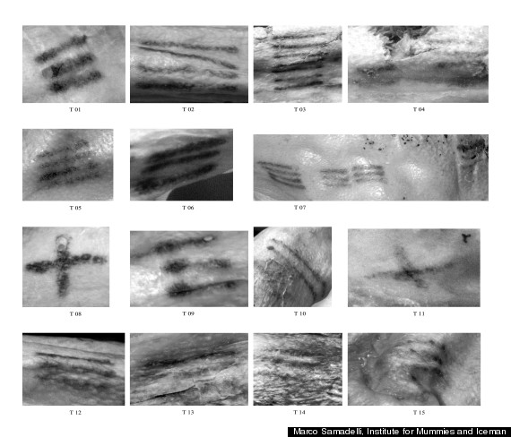
Decoration, communication and body mods
Body modifications = ancient human practices
Universal urge to edit ourselves and our functions or appearance.
We are very visually inclined
Ways of communicating through visual signals and body mods
Details of the tattoos on Otzi the iceman(mummy)
Notes:
We have been tattooing since the beginning of humanity tattoos made from cutting the skin and adding charcoal to it.
Ancient tattoos found on preserved bodies through images and historical records
They have symbolic meaning or could be used in rituals and medicinal practices.
Ancient tattoos found on preserved bodies through images and historical records
Because they were over his joints scientist assumed it was a method to treat pain
They have symbolic meaning or could be used in rituals and medicinal practices.

Slide 5
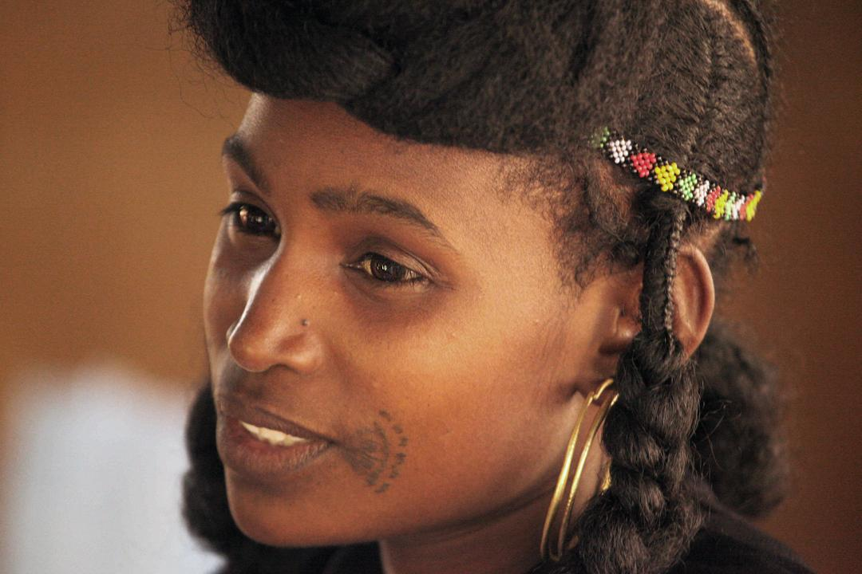
Decoration
The human body is boring so we decorate it
The human story, cultures
Symbolic representations of beauty
Embeddable pigments
Piercings, tattoos, scarring
Fulani woman
Notes:
Many cultures have different practices and beauty ideals many of which involve body decoration through embeddable or other types of modifications

Slide 6
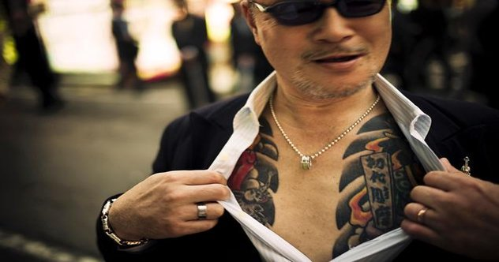
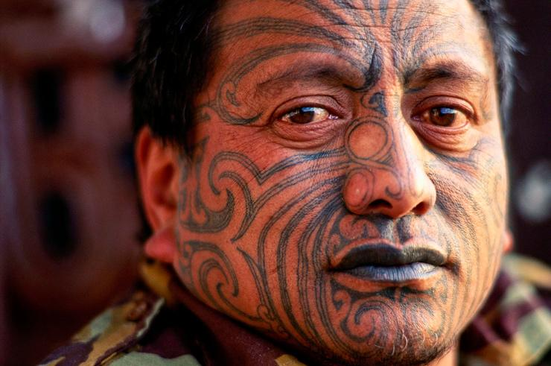
Communication
Visual key
Traditionally used to communicate associations, social status, etc.
Yakuza member showing off his tattoos
Body language
Maori tribes man
Notes:
A visual method of communication. This can be seen throughout the world in every culture.
Shift the way we look and read this body mods towards something disconnected from class or meaning and resulting in something that is there purely for decoration.

Slide 7
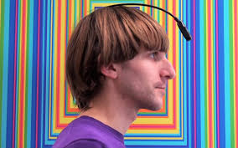
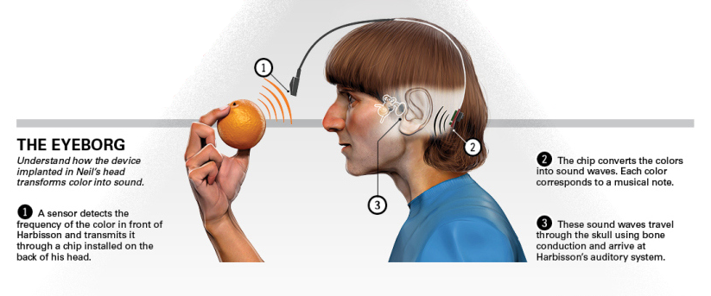
Communication
Visual modes of communication and representation through body art could either be used to communicate things to others or in this case communicate something to you
Neil Harbisson the human cyborg
Notes:
using embeddable tech to communicate something to us.
Born color blind at birth this embeddable tech allows him to hear colors. Devices communicating to you

Slide 8
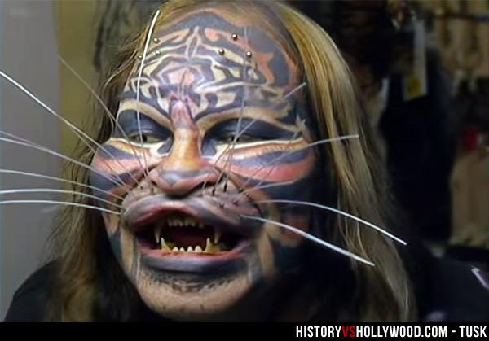
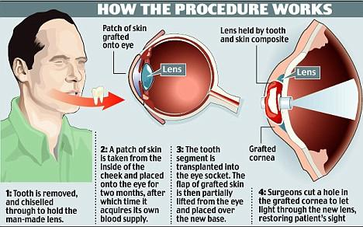
Reshaping
Changing/ evolving the body
Using tech to edit ourselves
Technology keeps advancing
Early adopters
Cat man
A process which is still in place and very active
Modern medical technology
Removing and adding to our structure
More or less practical purposes
Martin Jones, the man with a tooth for an eye
Notes:
We have constantly been reshaping our bodies again, since the dawn some are more drastic than others but the notion of cutting removing or adding something to and from our body is not foreign
Still challenges human morals and cultural norms.
more extreme modifications will become normalized eventually. They are early adopters for the future more invasive modification
Martin Jones became blind after a work incident and had his sight restored thanks to this medical procedure. Same concept as a camera.. So who knows for the future… maybe nanotechnology could act as a camera could change the amount of light that goes into the retina

Slide 9
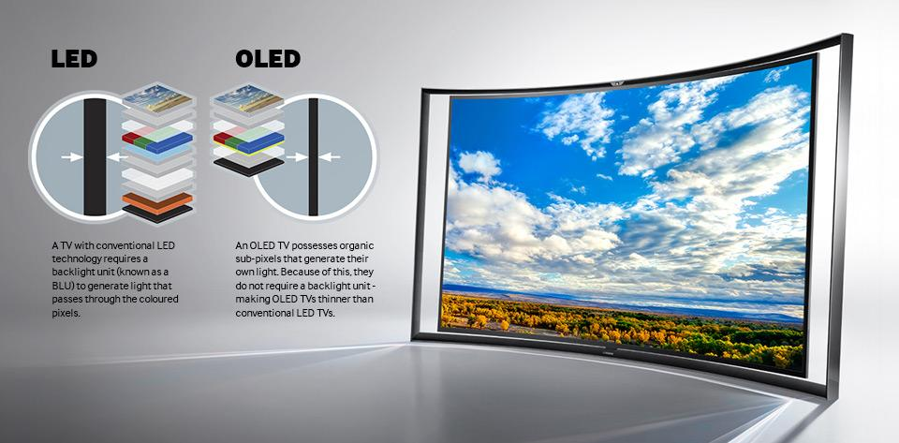
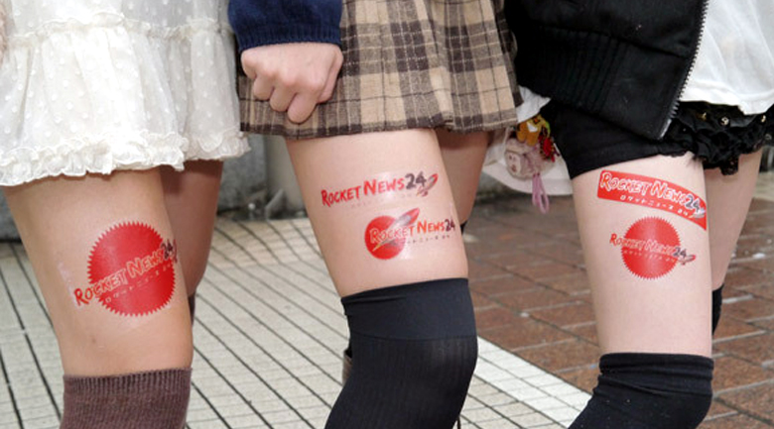
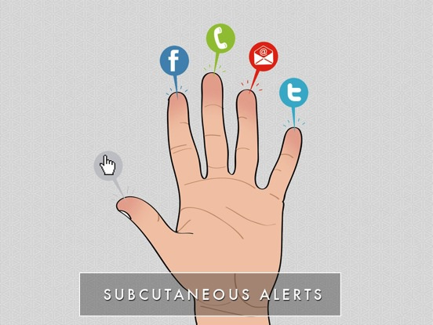
The future of body mods
Developments in OLED technology
flexible pigment screens
Nanoparticles : we become the screen
We could see fingers that light up according to your feeds.
Using nanoparticles to create ads onto the human canvas
Ads on Japanese girl’s legs
Notes:
OLED , organic LED is a technology that uses organic sub pixels that generate their own light making them thinner and more flexible
Possible avenue for ads

Slide 10
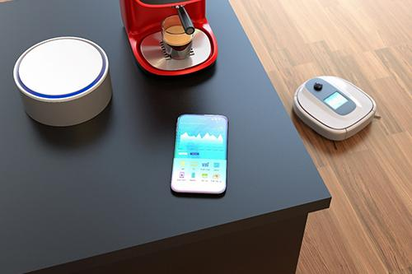
Future: moving away from screens
Screens:
something through which you look at something or something which block the view of something
ZERO UI : Movements glances and voice can be used to trigger a machine instead of traditional touch and screen interface
Transition from screen interface
Hands free! Devices getting more in touch with us!
Notes:
Shift toward removing the screen interface
In the future the screen will become obsolete
World with context awareness automatons and sensors
Plus the OLED tech
All of this in an attempt to minimize the time we gaze at things(screen)
Future where Pigment altering implants, in combination with other tech with remove the screen interface entirely

Slide 11
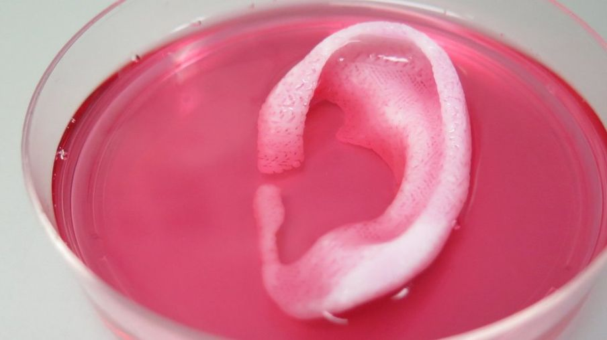
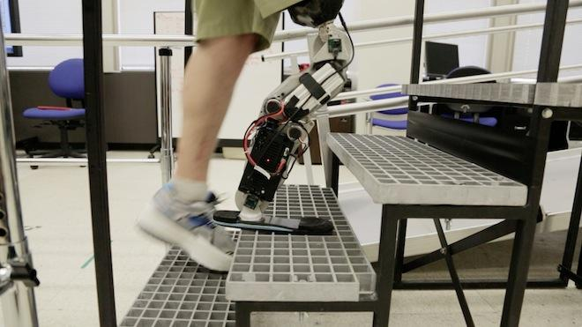
Optimization and Repair
*20th century vision: Weak, tin, poor eyesight human being with big head and brain
*WE PROVE THEM WRONG!
*We optimize our body
*We repair our body
Notes:
http://www.bbc.com/news/health-35581454
https://www.wired.com/2013/10/is-this-brain-controlled-bionic-leg-the-future-of-prosthetics/

Slide 12
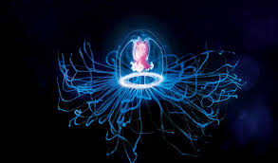
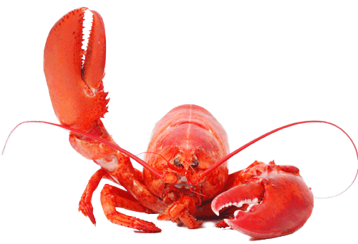
Stopping the Clock
*Body ages.
*We cannot stop progress of body ageing.
*Immortal/longer life span ->Animals
1-Lobsters
2-Jellyfish: Turritopsis dohrnii

Slide 13
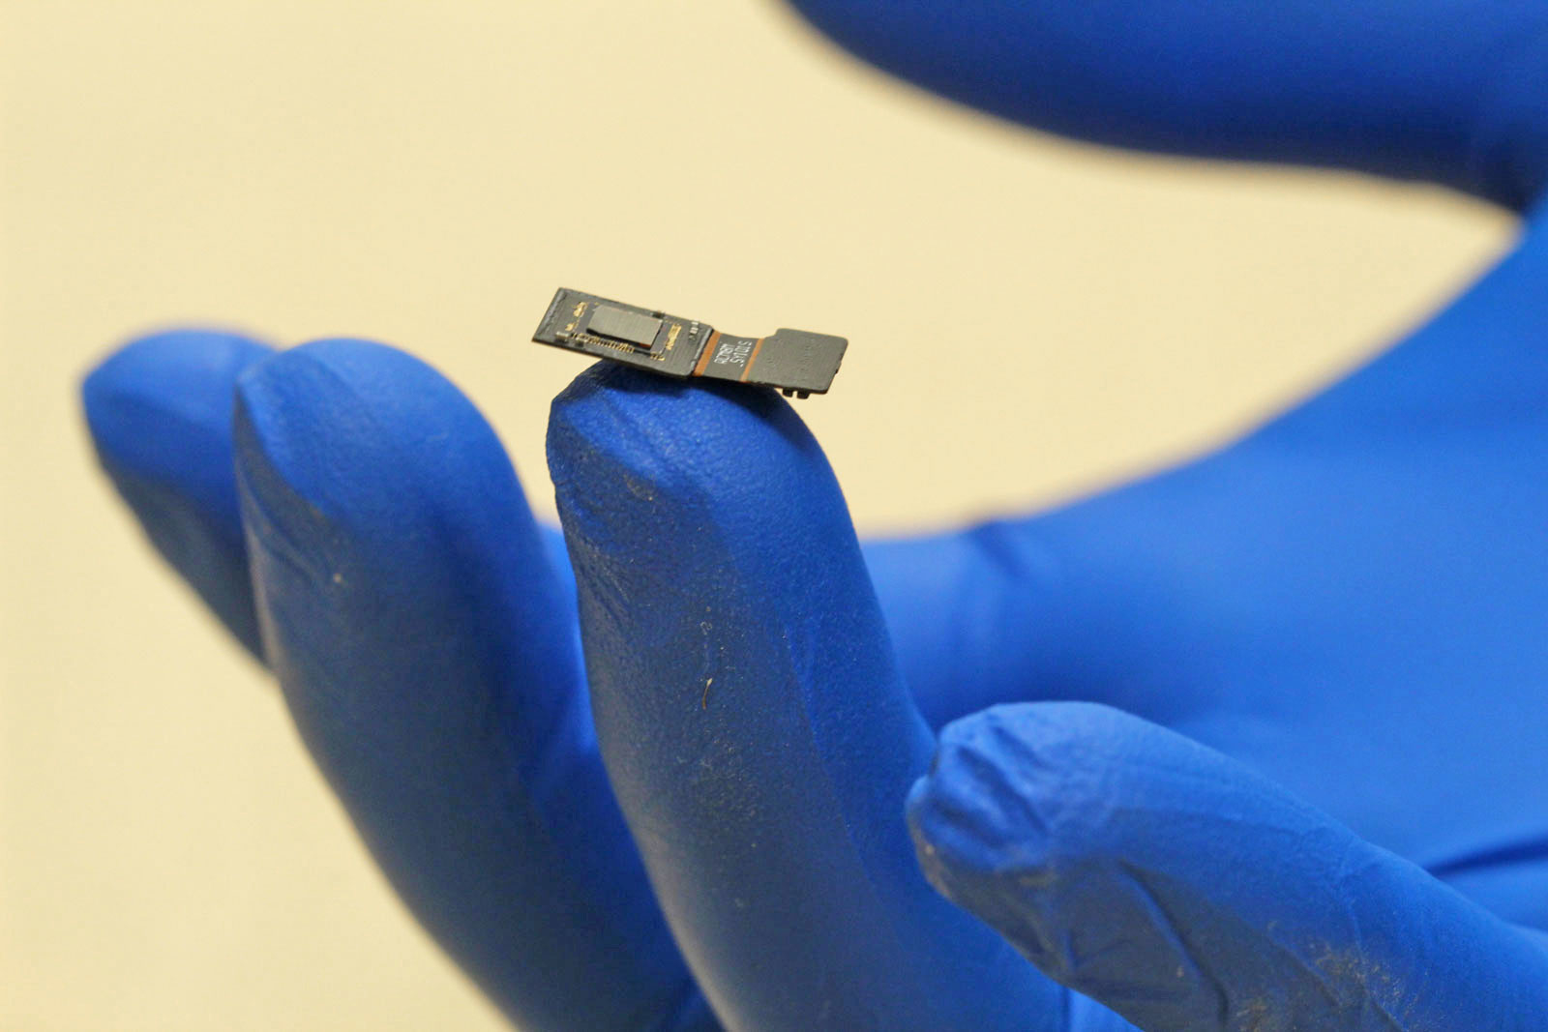
The Artificial Body
*Ways of repairing the body
1-robotic prosthetics
2-3D printed body parts
*Redefine the experience and definition of disablement
*Improve the body and eradicate any sensorial disablement.
*Neural Engineering System Design (NESD)
Notes:
https://www.darpa.mil/news-events/2017-07-10 Check this site!!! It’s implantables for neuro interfaces1!!!

Slide 14
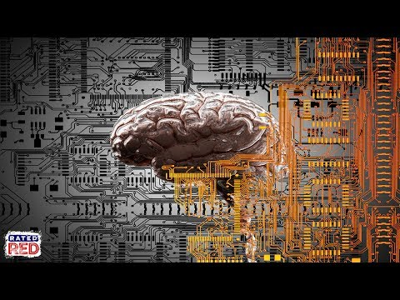
DARPA - Neural Engineering System Design

Slide 15
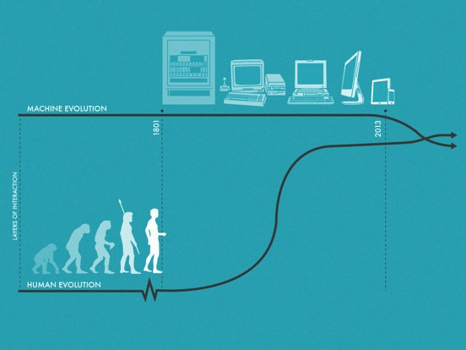
The Extended Human:
The motherLoad
We start off with a new technology, and spend the following decades refining it.
Where did we start? A world of computers for a closed off group of super intellectuals
Where did we go? We evolved into creating a relationship with the machine that favored the human - everyone could use them
Where are we? Human computer relationship that favors a screen interface
Where will we go next? Relationship with computers consisting of gestures and subtle body language that is the opposite of awkward (kinect holding out your arm- siri deciphering your words)
Notes:
With the world of computers the start of it that is, was quite secluded to a group of individuals who were engineers and intense intellectuals and kept working on big computer machines this started during and after world war 2 mind you, so very secretive and not really thinking about sharing their findings in technology of computation.
But something wonderful happened in the late 60s! There was a presentation of a computer and human interaction that would revolutionize the way we looked at and used computers! What was shown was a mouse, hypertext, video calls: all new interactions one human could utilize from computers.
This direction brought the public into computers and their tech, it was welcoming because it was in favor of humans.
“It is now almost entirely weighted toward the human languages of symbols, words, and gestures. Nevertheless, that last inch seems to be a vast chasm that is very hard to breach. “
We might take longer to achieve this next step in our technology based timeline. Due to the ethical topics that could come up; invasive, privacy, poisoning, hackability. Encryption. Personal. Also due to this slow progress our hope is to gain funcitoning embeddables by researching and developing algorithms: which can in turn learn on their own and learn our gene’s routine and function - dna - code - codes itself
We need to process the liability these embeddables could uphold in society
They are taking away the screen that divides individuals from interacting with one another. It is the future of our society and for the better of it too.

Slide 16
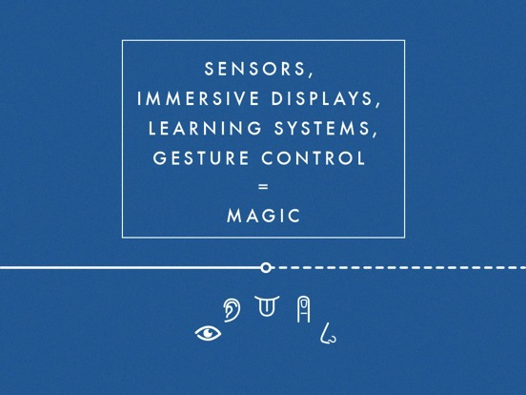


The Extended Human:
Sensory overload!
Sensors for everything!
How does it functions? Will it learn from our routines and gestures and develop?
Does predictive technology work for embeddables?
Notes:
Sensors can communicate with us
But they also have been developed to predict our next move and to plan accordingly, only this can lead to errors, therefore we are hoping the future will hold embeddable tech that will gives us what we want; they will need to have massive amount of data, and collect data on a daily basis in order to serve their purposes to us, although this will not be a natural process.
“ Big data will inform on-demand services, providing maximum efficiency and total customization. It will be a convincing illusion of perfect adaptation to need (Figure 8-5).”
The technology will improvise, adapt, overcome, in order to serve us.
They will become part of us

Slide 17
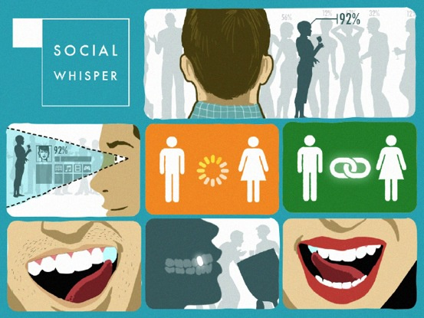
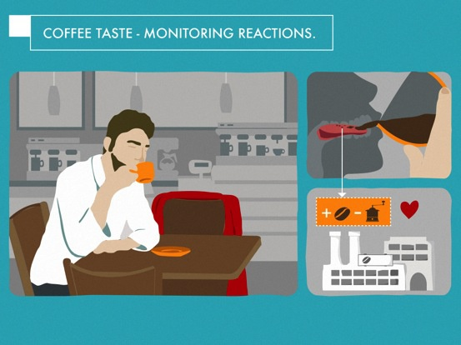
The Extended Human:
A new language of interaction!
Subtlety is the way to go: these micro gestures and expressions are totally intuitive.
Immersive displays: contact lenses screens powered by the user's own body’s kinetic and thermal energy.
Skin-top computer: Distributed circuitry on and in the body
Thought control: Mind controls of computer to mind controlling our own bodies movements and other people’s body: the subject can resist these controls.
Notes:
Figure 8-6 presents an interesting scenario for you to ponder: you see someone at a party you like; his social profile is immediately projected onto your retina—great, a 92 percent match. By staring at him for two seconds, you trigger a pairing protocol. He knows you want to pair, because you are now glowing slightly red in his retina screen. Then, you slide your tongue over your left incisor and press gently. This makes his left incisor tingle slightly. He responds by touching it. The pairing protocol is completed.
These sensory tech respond to our human movements which are already natural to us. Therefore implementing these tech into our society is a realistic goal; the tech seems subtle and intuitive. The tech has to be familiar and not foreign to the users, and reducing the amount of ridicule will most likely boost the result of the product in the market.
Social interactivity is about fitting in or finding your own niche while remaining comfortable to a certain extent, if these products could potentially allow us to connect on a subconscious level, it could redefine our ways of socializing via media and technology.
“This is the same for the gestural interface. Why swipe your arm when you can just rub your fingers together. What could be more natural than staring at something to select it or nodding to approve something? This is the world that will be possible when we have hundreds of tiny sensors mapping every movement, outside and within our bodies. For privacy, you’ll be able to use imperceptible movements, or even hidden ones such as flicking your tongue across your teeth.”
The reading is implying that subtlety and simplicity will facilitate these technologies to function alongside our daily routines.
The continuation of these technologies will prove the finite technology of screen interfaces.

Slide 18
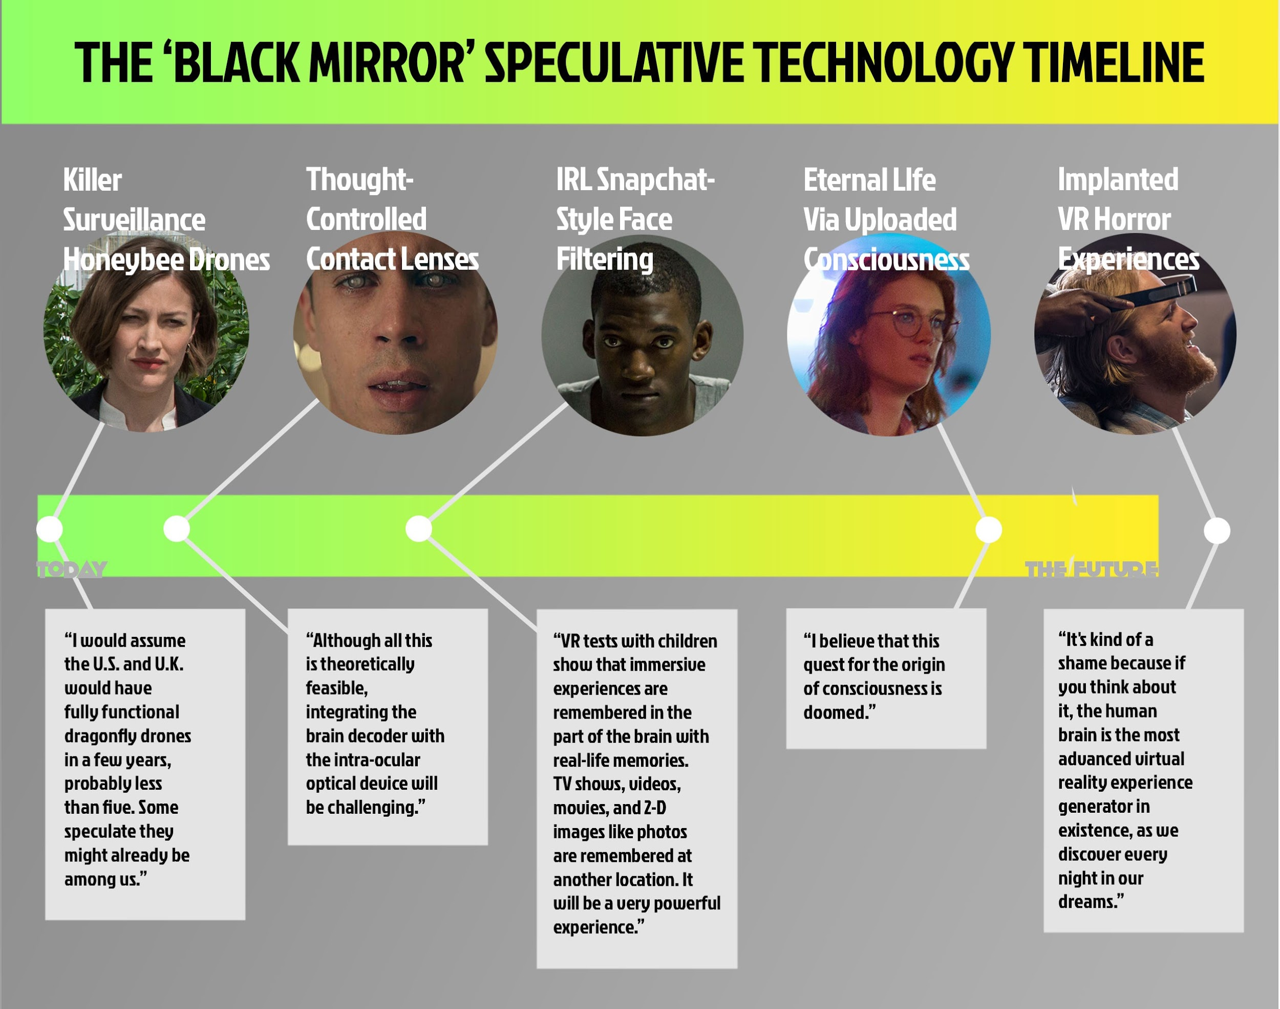
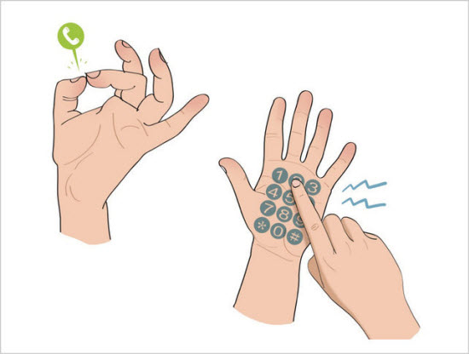
The Extended Human:
It’s a small world, it’s an embeddable world!
What will our world look like filled with embeddables in every aspect of our society?
Could we potentially eliminate the screens that “connect” us to the world while keeping us in a cycle of loneliness?
Notes:
The future of embeddables that may seem to constantly be brought up, is the constant fear that we are not operating under our own will, that somehow these tech gadgets inside of us will slowly taking over our mind and telling us what we want based on their own findings into our lives and how we make decisions, they'll calculate our mistakes and our happiness and find an algorithm that best suits us to avoid injury or pain. That’s a fear society has this urge to latch onto. As if preventing ourselves from swearing or behaving abnormally as this could cause ridicule and inflict pain to ourselves. This is not the direction these tech pieces are going for, they want to serve us, and give us what we want before we even know what we want, they are going to assume our every move and hopefully the end result is positively received by the user and other members of society.
There will no longer be screens to hide behind
People will interact as if there are no devices inside of them
Everything responds to our thoughts and gestures
Subtlety will be the innovative step towards the future of integrating embeddables into society.

Slide 19
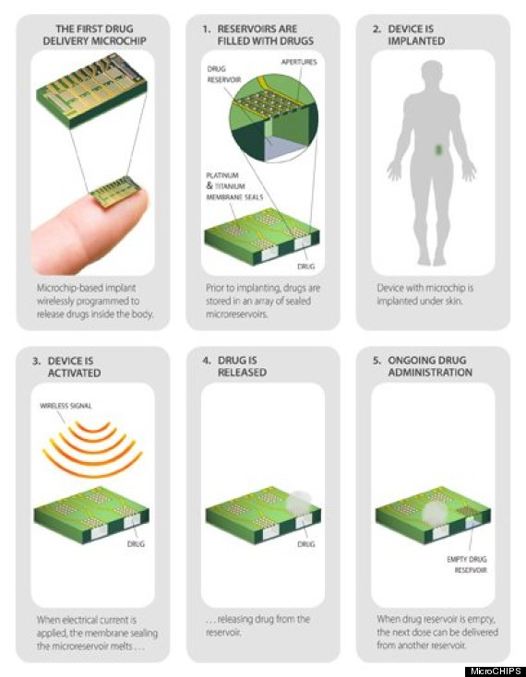
Extended Human:
A contraceptive implant with remote control
Bill Gates’ Foundation partnered with MIT to create a birth control microchip that can be turned on and off and could last up to 16 years.
It will be necessary to encrypt the chips to keep their wireless data flow private and secure.
The product is expected to hit the markets in 2018.
https://www.technologyreview.com/s/528121/a-contraceptive-implant-with-remote-control/
Notes:
The device measures 20 x 20 x 7 millimeters, and it is designed to be implanted under the skin of the buttocks, upper arm, or abdomen. It dispenses 30 micrograms a day of levonorgestrel, a hormone already used in several kinds of contraceptives. Sixteen years’ worth of the hormone fits in tiny reservoirs on a microchip 1.5 centimeters wide inside the device. MicroCHIPS invented a hermetic titanium and platinum seal on the reservoirs containing the levonorgestrel. Passing an electric current through the seal from an internal battery melts it temporarily, allowing a small dose of the hormone to diffuse out each day.
Allowing women to take control of their reproductive health is super good for society
Instead of forgetting your scheduled pill this ,microchip does it for you at precisely the right time
What do you think of this product? Would you support this? Try it out? I WOULD!!!!

Slide 20
Question time!!!!!!!!!!!!!!
Will the embeddable technology become so advanced that it will be forcibly integrated into our society and its citizens for the betterment of our world? Mandatory to wear embeddables?
Will we reach a point in technology where we will no longer have the need to use screens?
Notes:
Health, monitoring, purchasing, gps tracking

Slide 21
Sources, etc

